Slide 1
Online marketing
Topic : Groceries
1.Priyanka
2.Janani
3. Srilatha
4. Swetha Rani

Slide 2
Abstract
Main abstract of this project is to provide groceries like vegetables..
This project also provides fruits and ice creams
The customer register the groceries page then order the products then buy the products also

Slide 3
INTRODUCTION
In today’s busy world time is real constraint.
Hectic work schedule hardly leaves any leisure time for the working class
There is no think however, whose invention provide to be of great help to the mankind
To add the list of items that can be brought online are groceries

Slide 4

HOME PAGE

Slide 5
LANGUAGES USED
HTML : This is used to provide basic layout of the application
CSS : This is used to provide Styling of background and to provide good design to the webpage

Slide 6
The system will display all the items a customer wants to purchase.
Admin provides a unique username and password for each employee through they can login.
The amount can be paid either in cod or via online according to the customer preference.
First activity is adding the items to the system along with their rates and names of the items which will be up for sale in the page.

Slide 7
This authority is given only to Admin.
Any modification to be done in the item name or item rate can be done only by Admin.
Right to delete any item details rest with the Admin too.

Slide 8
ADVANTAGES
Reduced processing cost
Automatic updation of product details
Improved report generation and analysis
Reduction of use of paper
Reduction in man power
Faster response time

Slide 9
List of Attributes
Customer name
Address line
Contact no
Email ID
Ordered product
Product name
Product type
Product price

Slide 10
Types of Products
Vegetables
Fruits
Ice creams
MEAT

Slide 11

vegetables

Slide 12
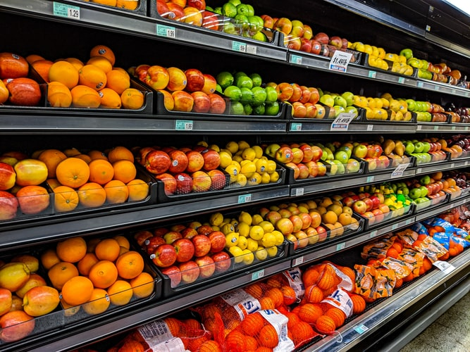
fruits

Slide 13

Non-veg items

Slide 14

Ice creams

Slide 15
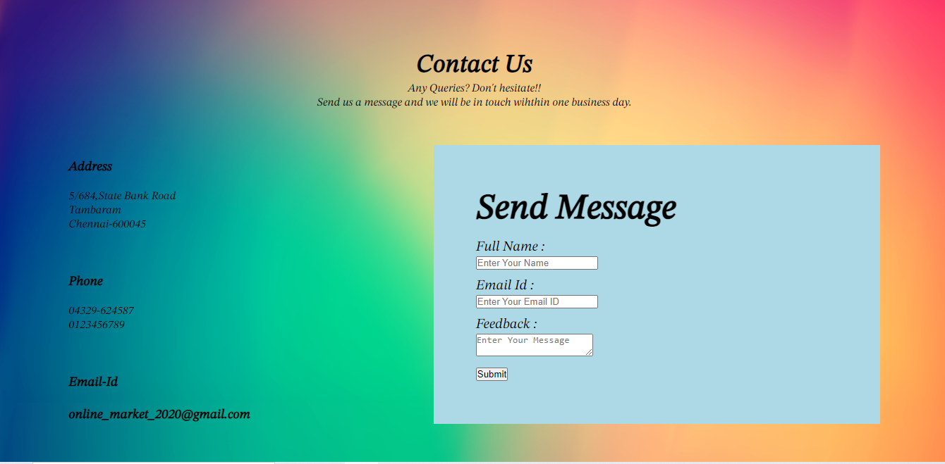
CONTACT US

Slide 16
CONTACT US
“CONTACT US” page is a very important page in the whole website, where it acts as a medium to the customers to interact.
Include an email and phone numbers so customers can quickly find the correct information.
Include a short form using fields that will help the business understand who’s contacting them.

Slide 17
Thank you

